Slide 1
Team MULTIFAN-CL: Indian Ocean yellowfin tuna
This is the Teal Title Slide, you can swap to the Blue 1 Title Slide or Blue2 Title Slide in the Layout menu
Spatial Stock Assessment Simulation Experiment
November 21/22, 2022
Webinar #2
Notes:
Overview of the terminology behind the main identifier.

Slide 2
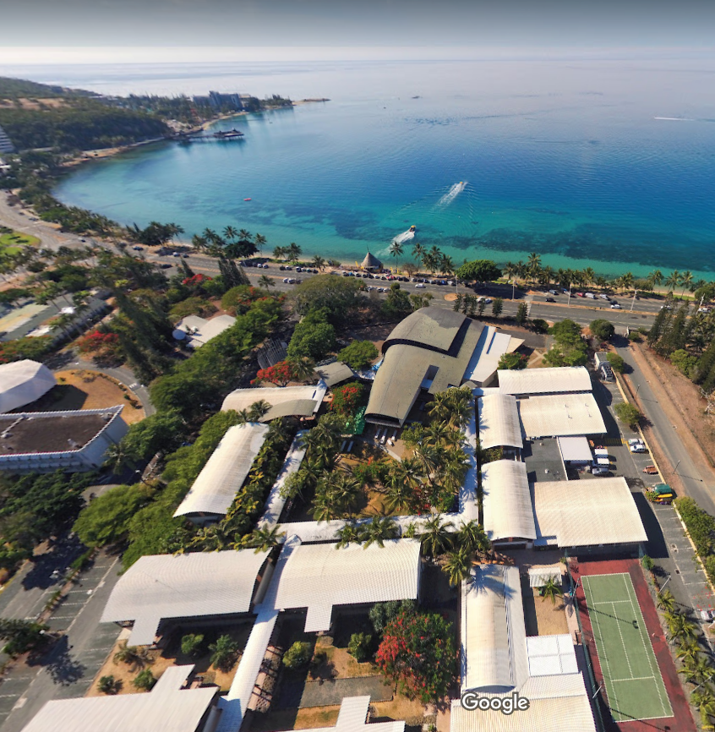
Team MULTIFAN-CL
Claudio Castillo Jordan (SPC)
Nick Davies¹ (Te Takina Ltd.)
Jemery Day (SPC)
Nicholas Ducharme-Barth¹ (NOAA PIFSC)
Paul Hamer (SPC)
John Hampton (SPC)
Arni Magnusson (SPC)
Thom Teears (SPC)
Matthew Vincent¹ (NOAA SEFSC)
1. Former SPC staff members
Credit: GYPAETE AERIAL
SPC Campus, Nouméa, New Caledonia

Slide 3
MULTIFAN-CL: A history
Integrated, statistical, size-based, age-structured and spatially structured model for fisheries stock assessment

Slide 4
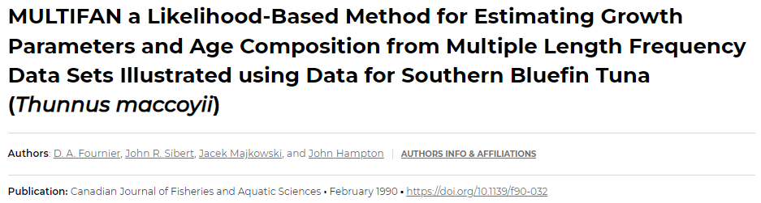
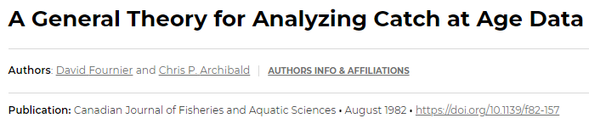
MULTIFAN-CL: A history
Integrated, statistical, size-based, age-structured and spatially structured model for fisheries stock assessment
Integrates the original MULTIFAN model (1990) used to estimate growth and proportions-at-age from length-frequency data with the Fournier and Archibald statistical age-structured model (1982)

Slide 5
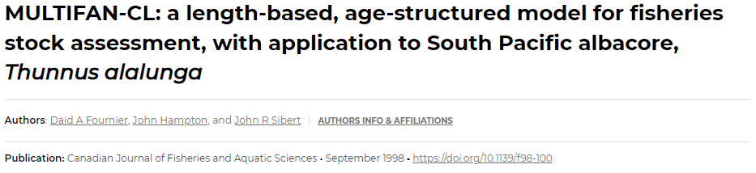
MULTIFAN-CL: A history
Integrated, statistical, size-based, age-structured and spatially structured model for fisheries stock assessment
Integrates the original MULTIFAN model (1990) used to estimate growth and proportions-at-age from length-frequency data with the Fournier and Archibald statistical age-structured model (1982)
First MULTIFAN-CL model applied in 1998 to South Pacific albacore tuna

Slide 6
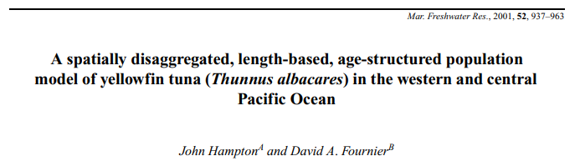
MULTIFAN-CL: A history
Integrated, statistical, size-based, age-structured and spatially structured model for fisheries stock assessment
Integrates the original MULTIFAN model (1990) used to estimate growth and proportions-at-age from length-frequency data with the Fournier and Archibald statistical age-structured model (1982)
First MULTIFAN-CL model applied in 1998 to South Pacific albacore tuna
Further modified in 2001 to allow for spatial structure, movement, and inclusion of tagging data.

Slide 7
MULTIFAN-CL: A history
Integrated, statistical, size-based, age-structured and spatially structured model for fisheries stock assessment
Integrates the original MULTIFAN model (1990) used to estimate growth and proportions-at-age from length-frequency data with the Fournier and Archibald statistical age-structured model (1982)
First MULTIFAN-CL model applied in 1998 to South Pacific Albacore tuna
Further modified in 2001 to allow for spatial structure, movement, and inclusion of tagging data.
Developed to analyze spatially complex fisheries with little to no age data, but where length (size) frequency and tagging data were available.

Slide 8
MULTIFAN-CL: Spatial considerations
Tagging
Release conditioned
Length at release needed (not age), region, time (year & month)
Tracks populations of tagged fish by release group
Multiple likelihoods available
Need to define
Mixing period
Fishery reporting rates (can be estimated)
Movement
Recruitment

Slide 9
MULTIFAN-CL: Spatial considerations
Tagging
Movement
Two movement coefficients (bi-directional) estimated for each adjacent region
However, movement between two non-adjacent regions is possible within a single time step
Quarterly and age specific movements can also be estimated if there is sufficient information
Recruitment

Slide 10
MULTIFAN-CL: Spatial considerations
Tagging
Movement
Recruitment
Assumes a single stock-recruit relationship applies to all regions
e.g., spawning biomass is pooled across regions to determine total recruitment across regions
Average recruitment apportionment to each region can be estimated
Temporal variation in recruitment (estimated) can be shared across regions, or regional recruitment deviates can also be estimated

Slide 11
MULTIFAN-CL: Usage
Used almost exclusively by the Pacific Community (SPC) to produce assessments for the Western and Central Pacific Fisheries Commission (WCPFC)
Assessments are predominantly spatial in nature, most include tagging data and estimate movement, most do not directly incorporate age data
Recently assessed species & regional structures
2022 Western and Central Pacific Ocean (WCPO) skipjack tuna (8 regions)
2020 WCPO bigeye tuna (9 regions)
2020 WCPO yellowfin tuna (9 regions)
2021 South Pacific albacore tuna (4 regions)
2019 Southwest Pacific Ocean striped marlin
(1 region)
2021 Southwest Pacific Ocean swordfish
(2 regions)
MULTIFAN-CL users
People who have worked at SPC

Slide 12
Model development - Pathway
Single region model
Composition data likelihood
Catch errors v. catch-conditioning
Fishery structure & selectivity groupings

Slide 13
Model development - Pathway
Single region model
Composition data likelihood
Catch errors v. catch-conditioning
Fishery structure & selectivity groupings
Start developing four region model

Slide 14
Model development - Pathway
Single region model
Composition data likelihood
Catch errors v. catch-conditioning
Fishery structure & selectivity groupings
Effective sample size
Inclusion of tagging data
Start developing four region model

Slide 15
Model development - Pathway
Single region model
Composition data likelihood
Catch errors v. catch-conditioning
Fishery structure & selectivity groupings
Effective sample size
Inclusion of tagging data
Start developing four region model
Use 20 fleet single region model
Selectivity groupings
Movement
Recruitment
Tagging data
Mixing period
Models checked for convergence (low gradient & Hessian)

Slide 16
Model development - Pathway
Single region model
Composition data likelihood
Catch errors v. catch-conditioning
Fishery structure & selectivity groupings
Effective sample size
Inclusion of tagging data
Start developing four region model
Multifan-CL modifications/fixes
Catch-conditioned model
Initial conditions based on M
Dynamic depletion with stock-recruit adjustment
Chronic tag shedding
Use 20 fleet single region model
Selectivity groupings
Movement
Recruitment
Tagging data
Mixing period
Models checked for convergence (low gradient & Hessian)

Slide 17
Single region – Initial model
Did not work with the 5x5 spatial data
Began with 7 extraction fisheries + 1 index fishery
Each of the 8 fisheries estimated an independent age specific selectivity curve using a 3 node cubic spline
Longline & index fishery assumed to be non-decreasing
Pseudo-catch conditioned model
Robust Normal likelihood for length composition data
Sample size of 5 for the length composition data
Quarterly fishery and recruitment time step
Assumed from OM
Growth
Steepness
M
Maturity
Initial conditions
General selectivity shape
Stock-recruit curve penalty
CPUE observation error

Slide 18
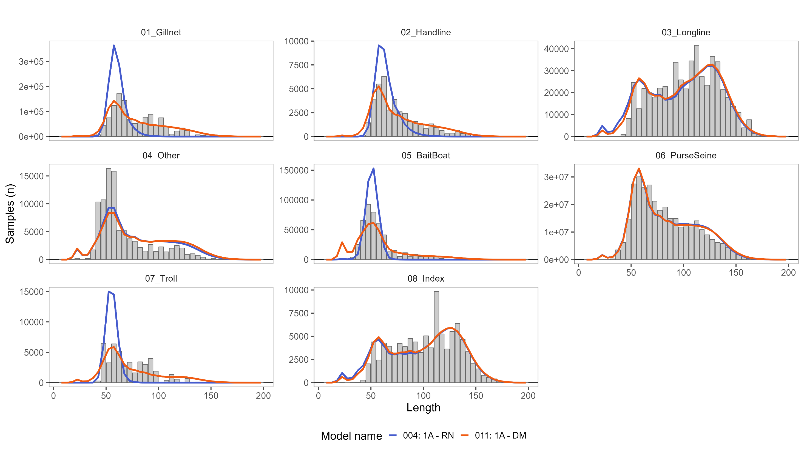
Single region – Length comp likelihood
Switching to Dirichlet Multinomial
improved fit to length data & index
improved run time and convergence

Slide 19
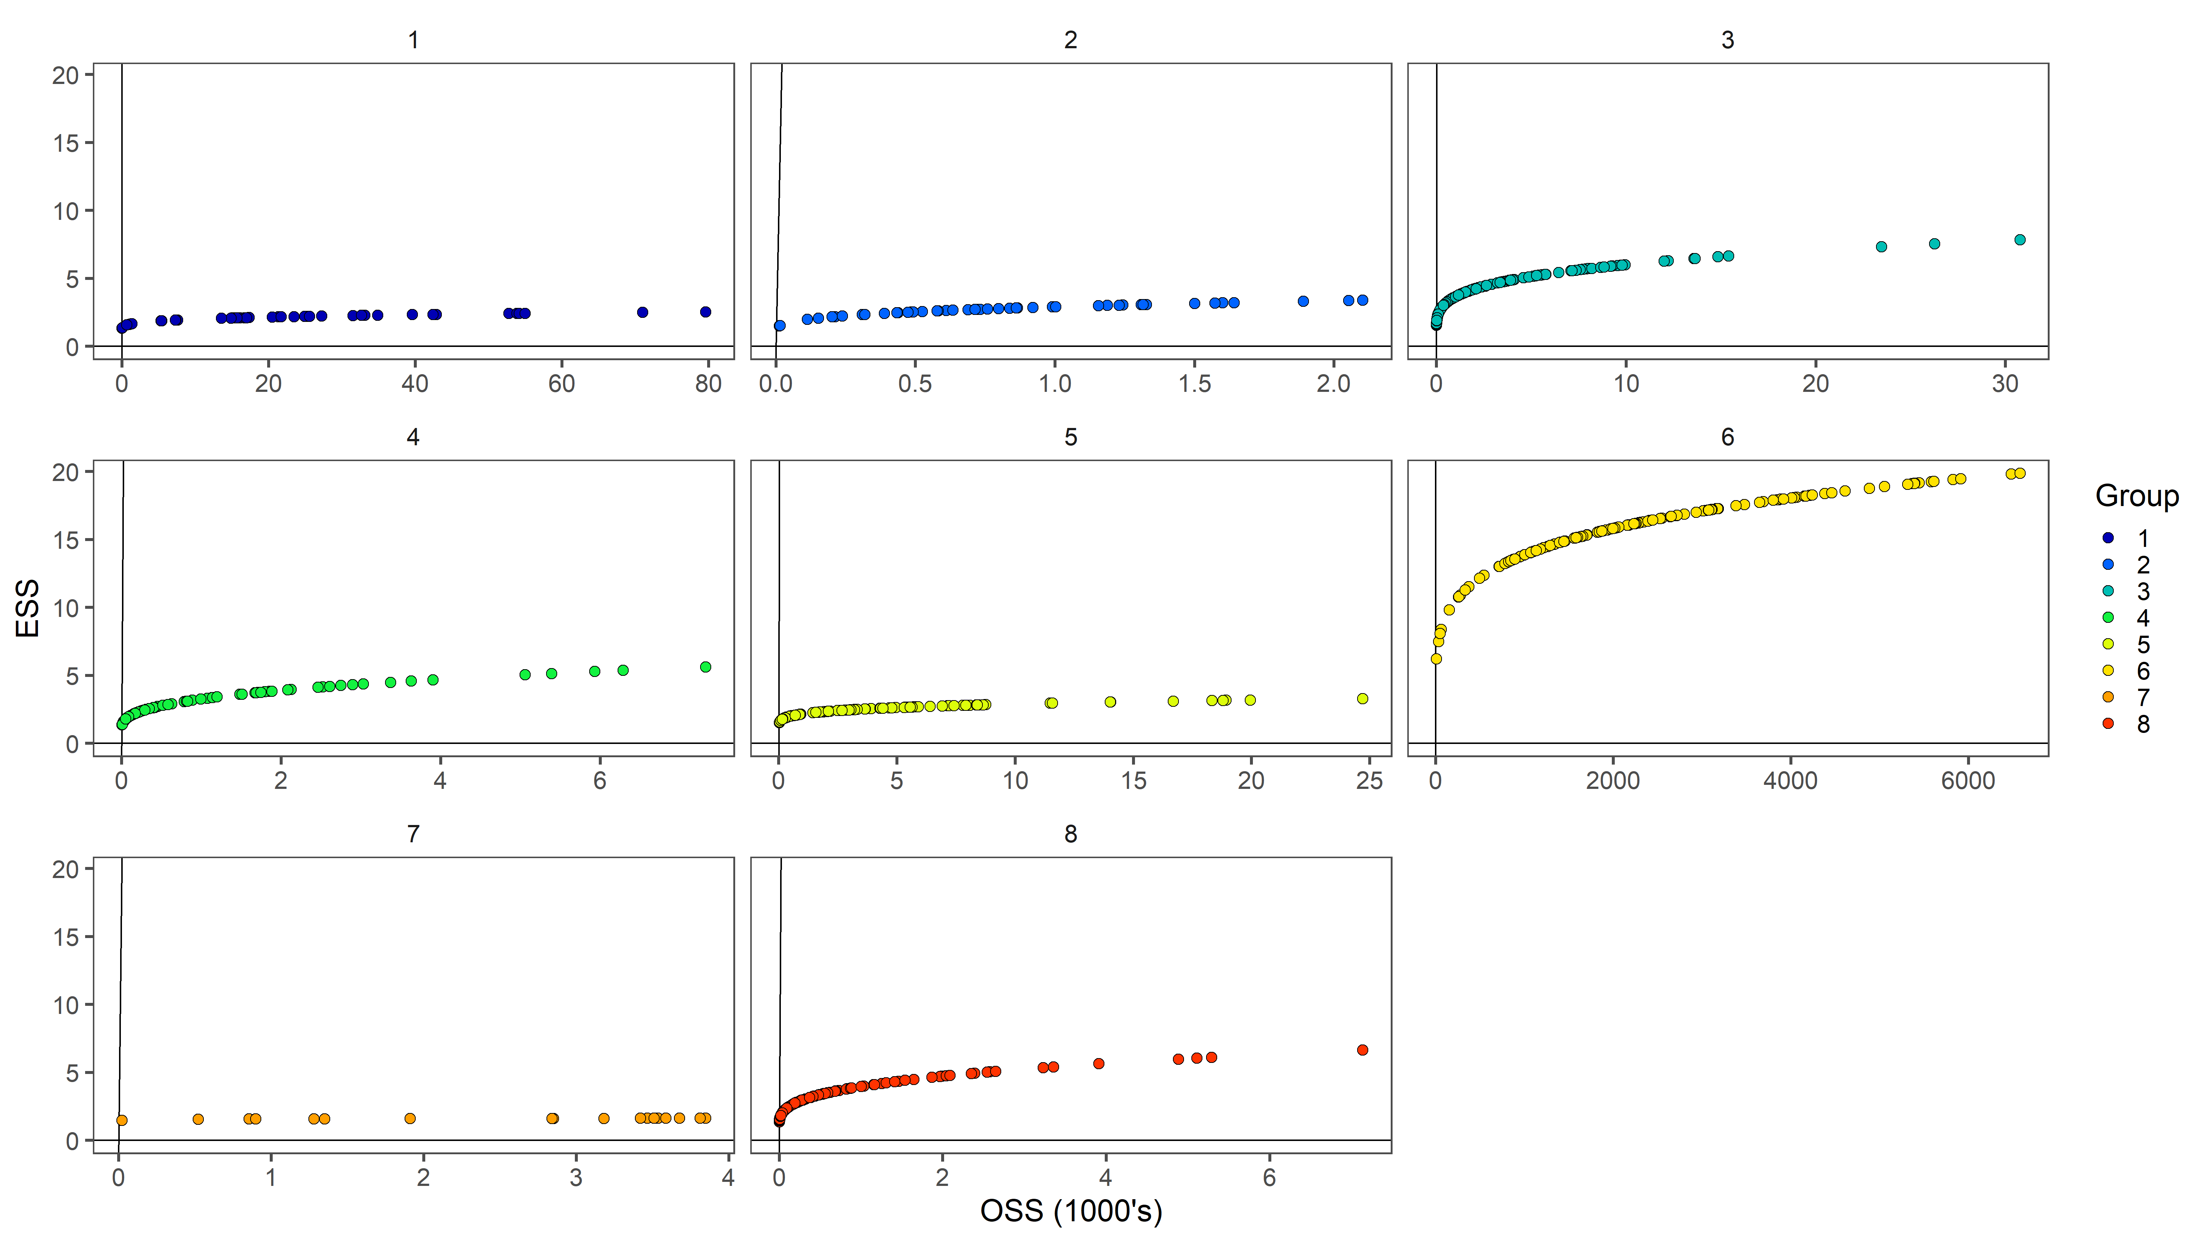
Single region – Length comp likelihood
Dirichlet Multinomial (Self-scaling)
Estimates two scaling parameters per fishery group
Sensitive to fishery groupings & maximum sample size (user-defined)

Slide 20
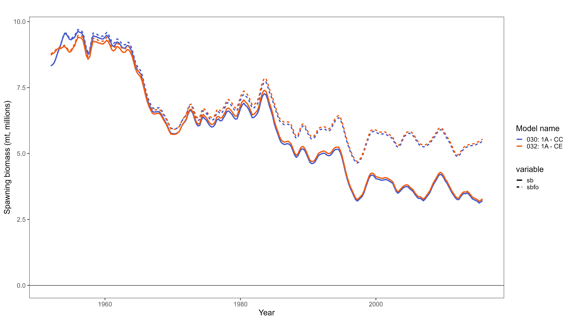
Single region – Catch conditioning

Slide 21
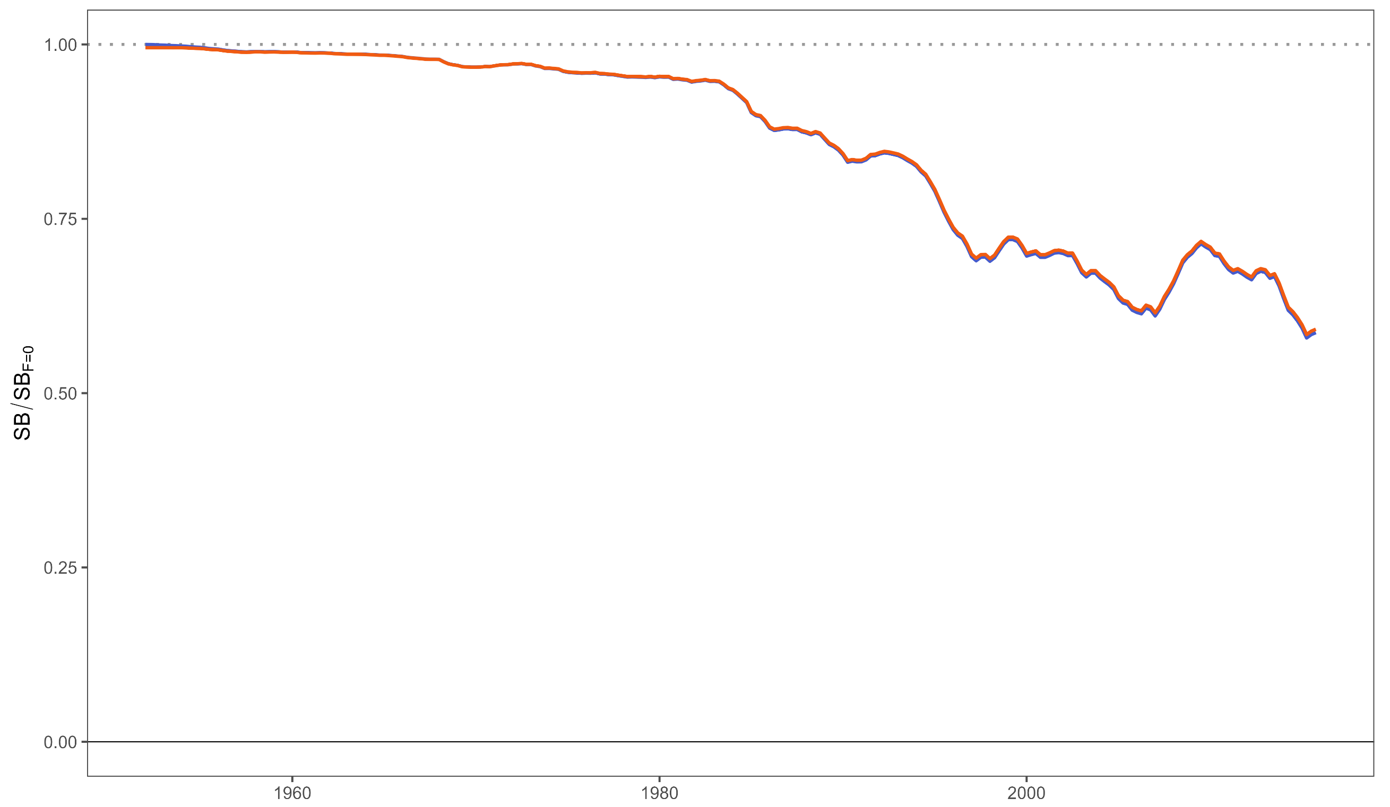
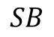
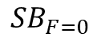
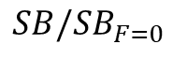
Single region – Catch conditioning
$$SB_{F=0}$$
$$SB/SB_{F=0}$$
$$SB$$

Slide 22
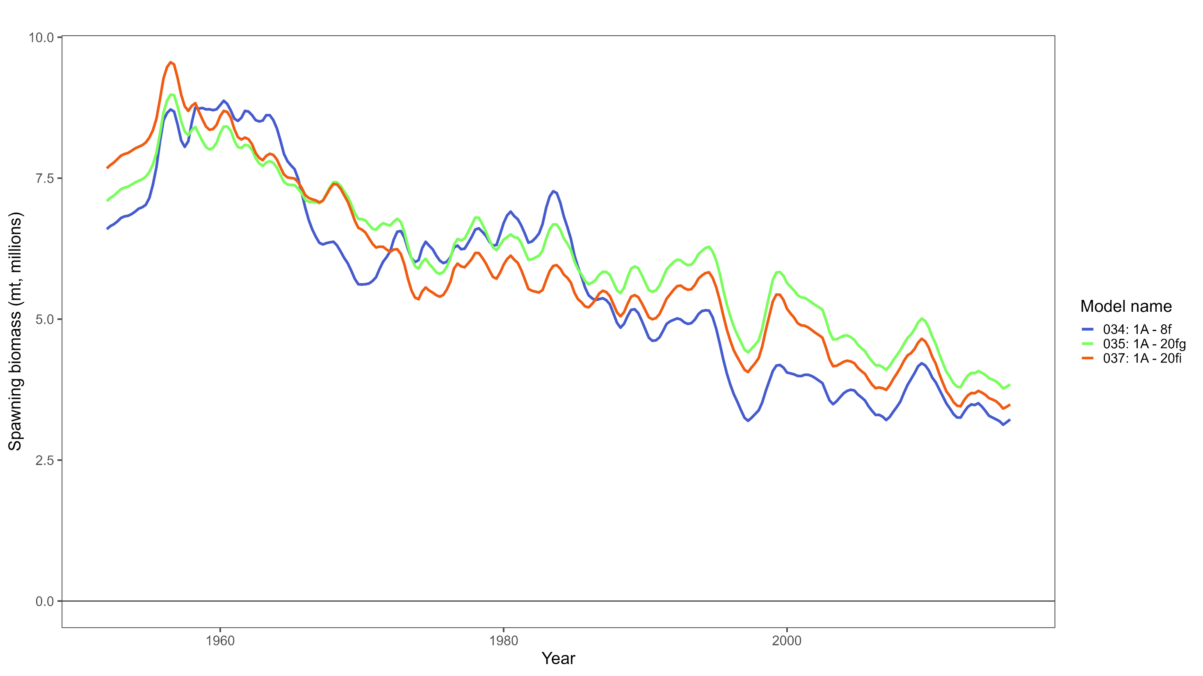
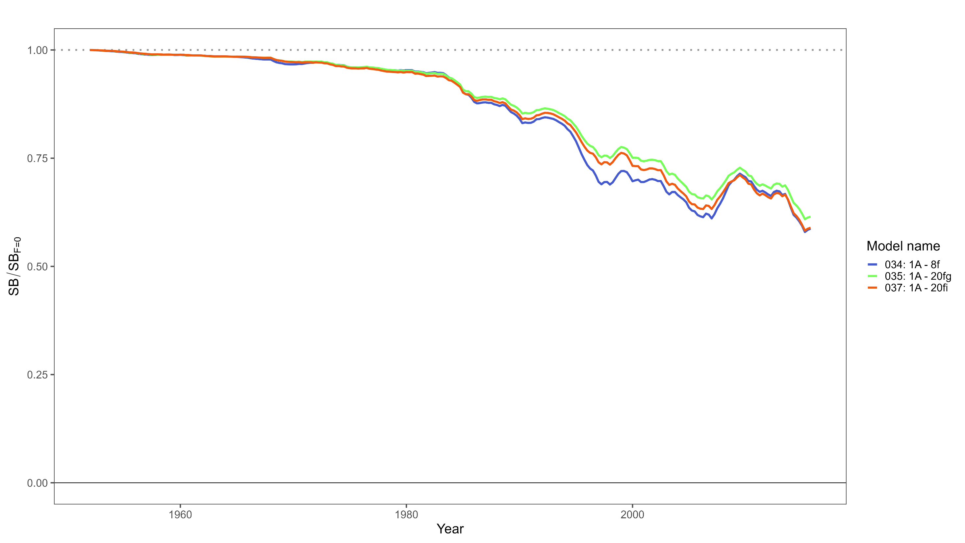
Single region – Fisheries groupings
Model 034
7 extraction fisheries (gear specific) + 1 index fishery
7 selectivity and length comp groupings
Model 035
16 extraction fisheries (gear/region specific) + 4 index fisheries
7 selectivity and length comp groupings (gear specific)
Model 037
16 extraction fisheries (gear/region specific) + 4 index fisheries
14 selectivity groupings (gear/region specific)
7 length comp groupings (gear specific)

Slide 23
Single region – Fisheries groupings
Ultimately selected Model 034 based on OM documentation after much discussion
7 extraction fisheries (gear specific) + 1 index fishery
7 selectivity and length comp groupings
In an operational assessment index fishery would typically receive its own composition data weighted by the spatial CPUE, and the extraction fishery composition would be re-weighted by the spatial catch
Opportunity for further investigations into how fisheries are defined and groupings used to define selectivity and composition groupings

Slide 24
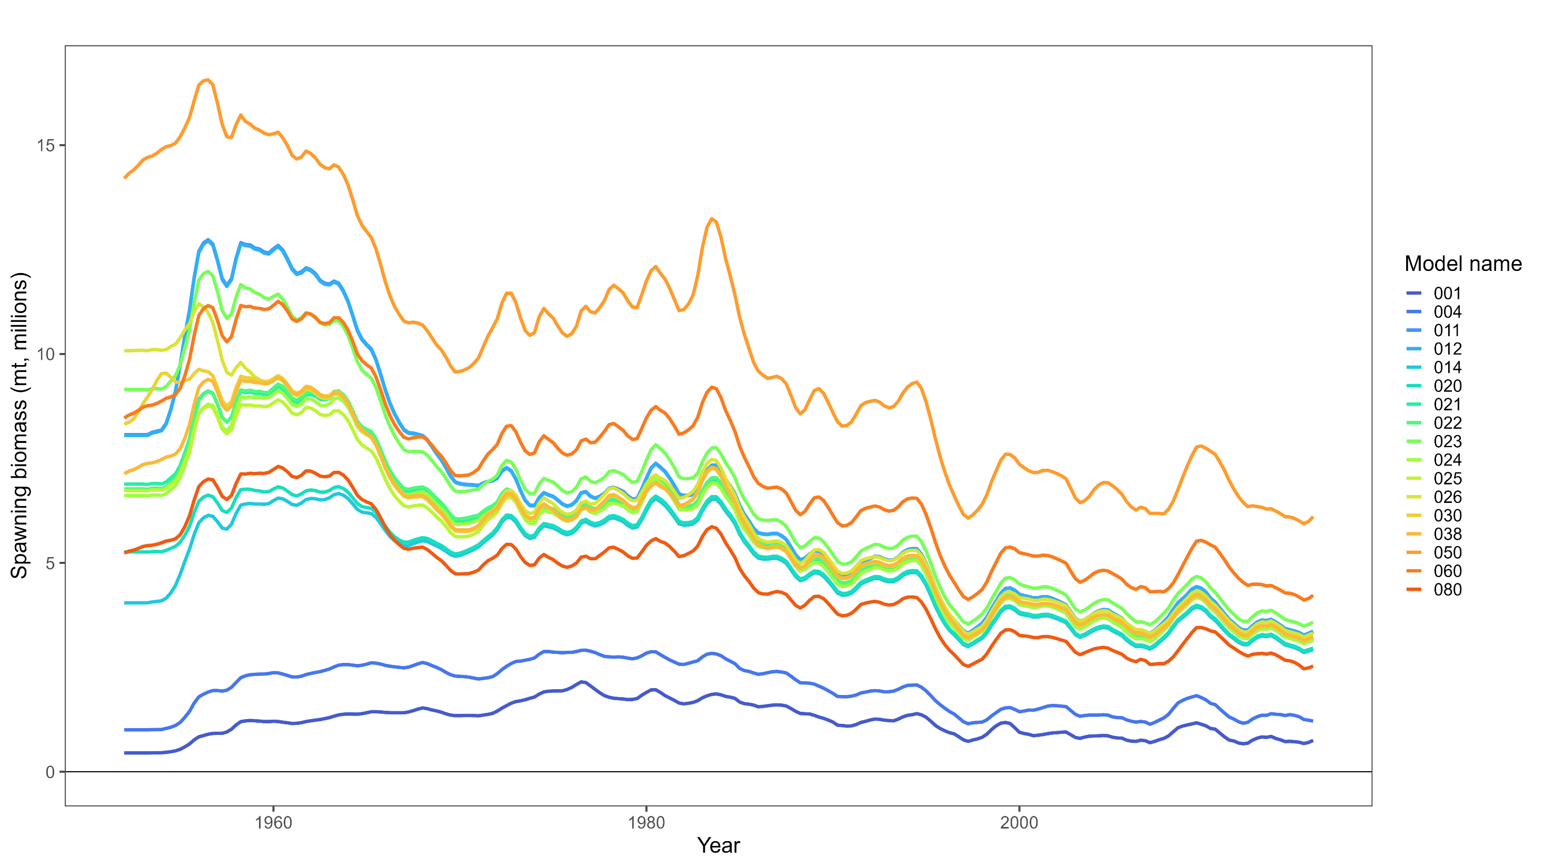
Single region – Current model
7 extraction fisheries + 1 index fishery
Index selectivity shared with longline fishery
7 fisheries age specific selectivity curve using a 7 node cubic spline
Longline & index fishery assumed to be logistic curve
Catch-conditioned model
Dirichlet-Multinomial (self-scaling)
Raw sample size used for the length composition data
Quarterly fishery and recruitment time step
Inclusion of tags
Mixing periods = 4 or 5

Slide 25
Single region – Current model
7 extraction fisheries + 1 index fishery
Index selectivity shared with longline fishery
7 fisheries age specific selectivity curve using a 7 node cubic spline
Longline & index fishery assumed to be logistic curve
Catch-conditioned model
Dirichlet-Multinomial (self-scaling)
Raw sample size used for the length composition data
Quarterly fishery and recruitment time step
Inclusion of tags
Mixing periods = 4 or 5

Slide 26
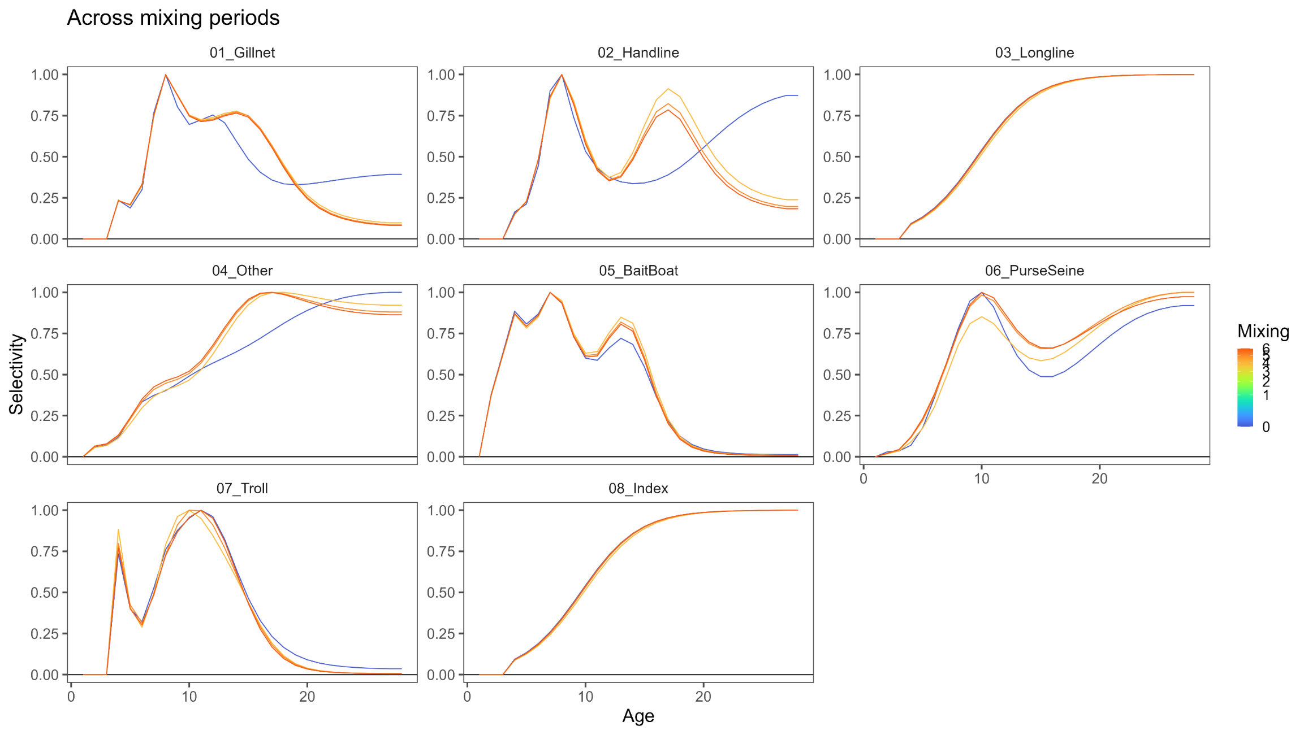
Single region – Current model
Shape of selectivity curve sensitive to inclusion of tagging data…

Slide 27
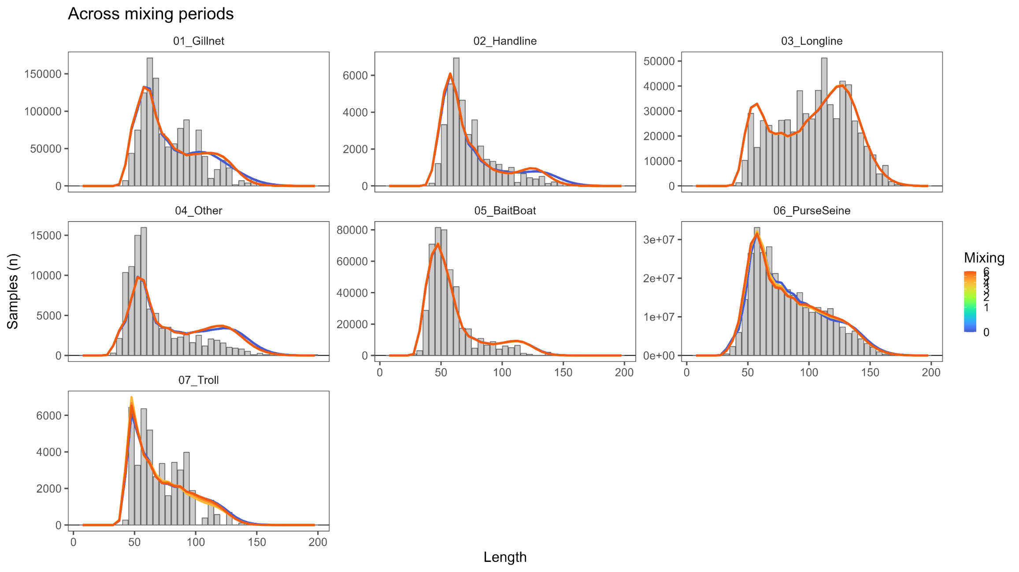
Single region – Current model
…but does not result in meaningfully different fits to the length composition data.

Slide 28
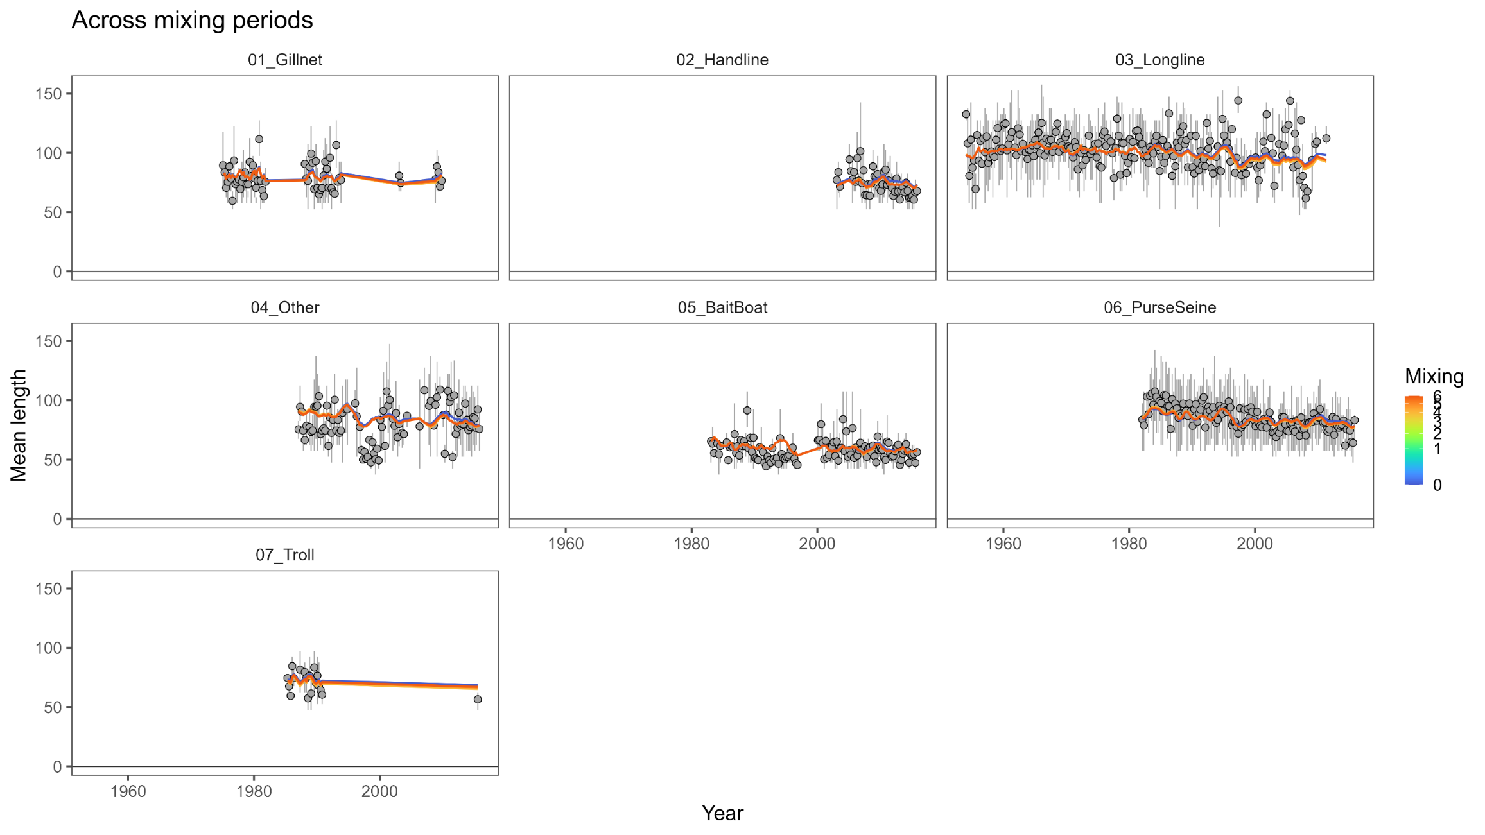
Single region – Current model

Slide 29
Single region – Current model

Slide 30
Single region – Current model

Slide 31
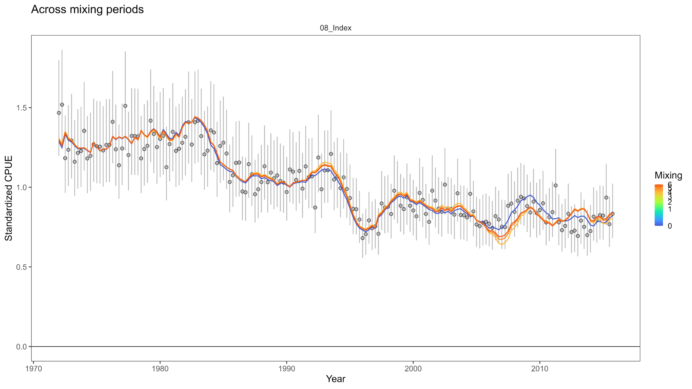
Single region – Current model

Slide 32
Single region – Current model
Conflict between tagging and CPUE data?

Slide 33
Single region – Current model
Conflict with purse seine length composition data?
Conflict between tagging and CPUE data?

Slide 34
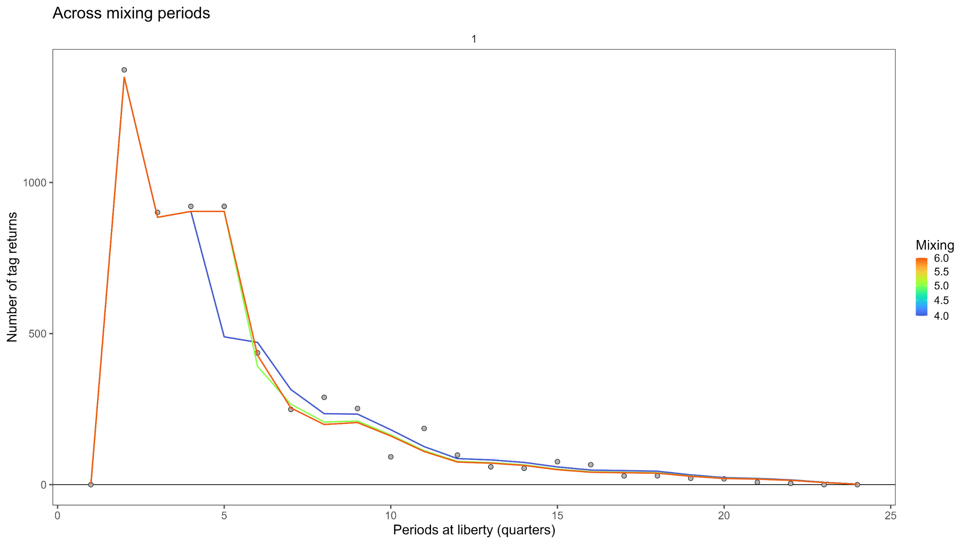
Single region – Current model

Slide 35
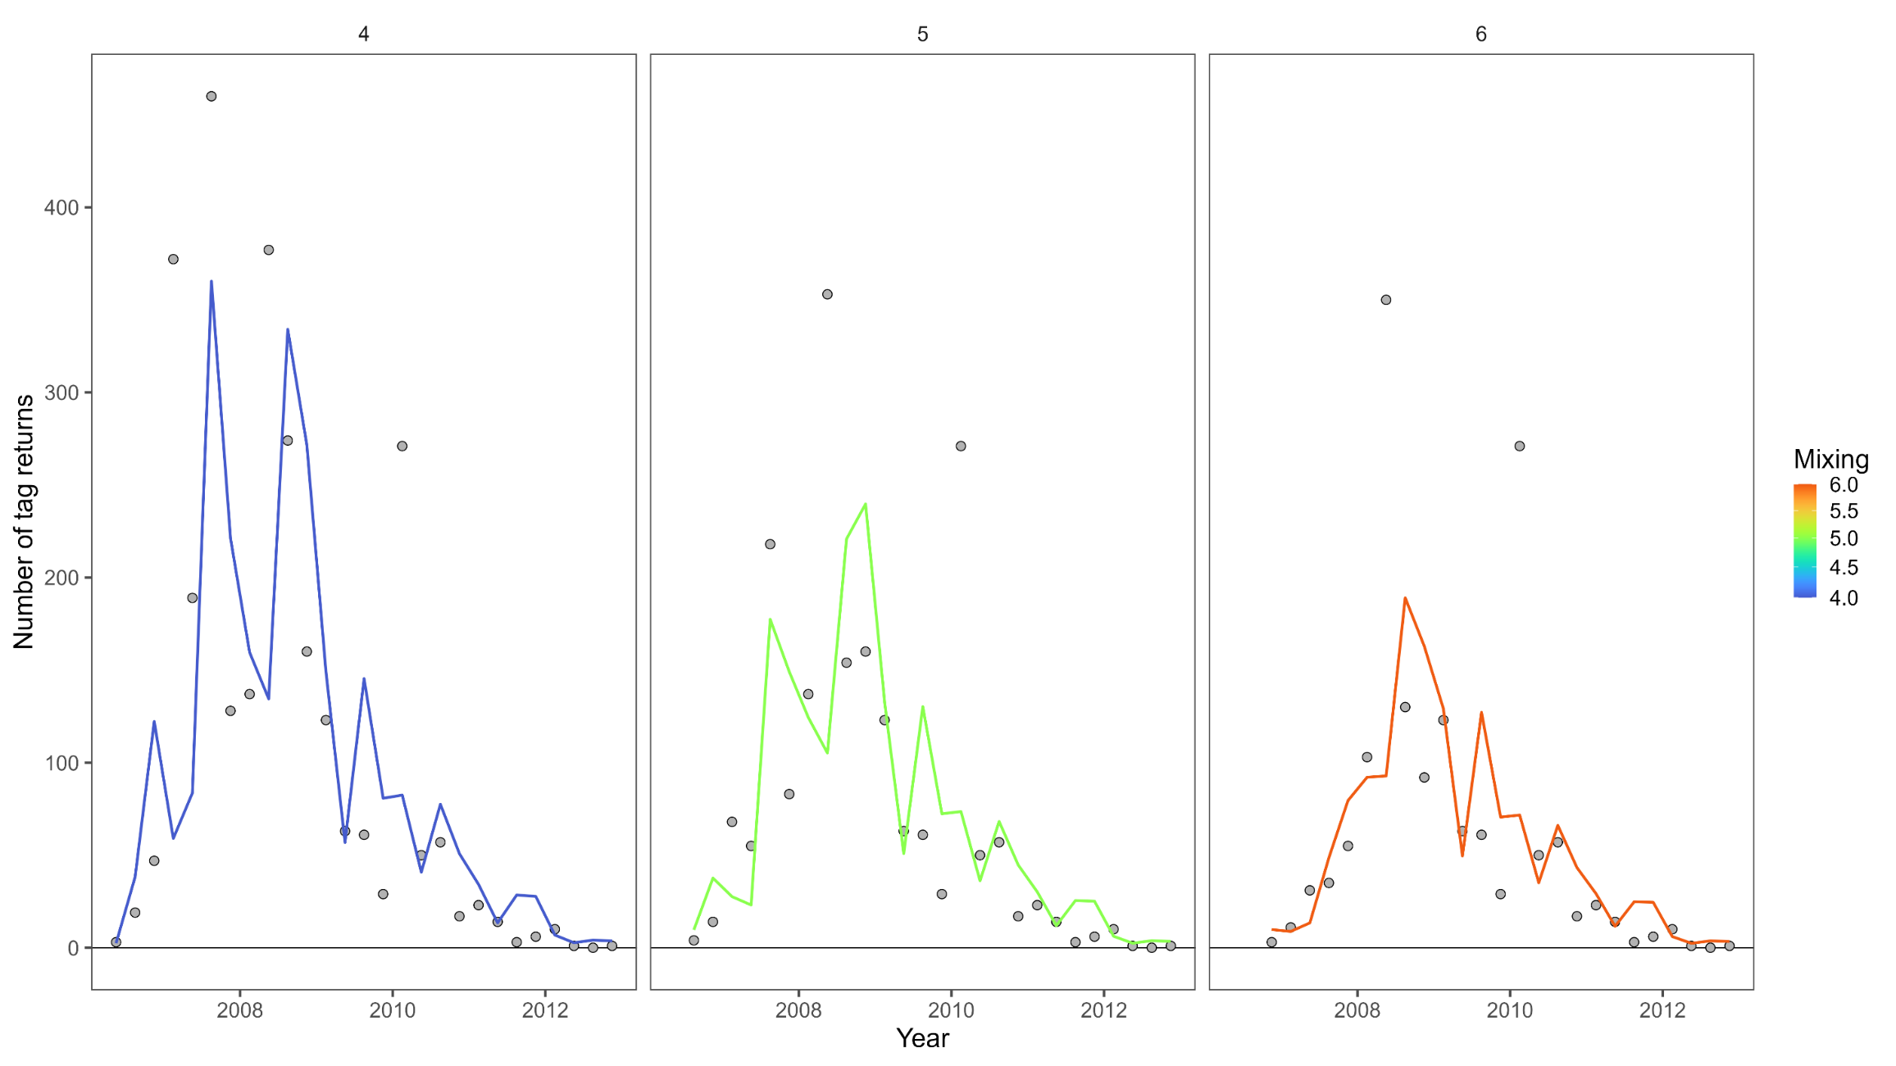
Single region – Current model

Slide 36
Single region – Current model

Slide 37
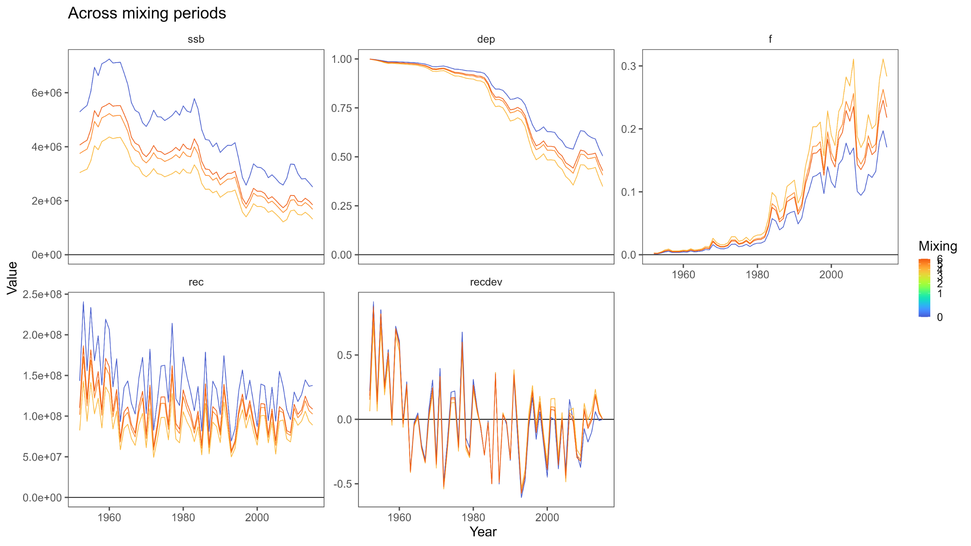
Single region – Current model

Slide 38
Single region – Current model
Little information (limited length comp & no CPUE) from which to estimate recruitment.
Would be better to constrain deviates to 0 for this early period but not feasible in MULTIFAN-CL.

Slide 39
Single region – Current model
Dynamic depletion is robust to spurious high early biomass estimates
Little information (limited length comp & no CPUE) from which to estimate recruitment.
Would be better to constrain deviates to 0 for this early period but not feasible in MULTIFAN-CL.

Slide 40
Four region – Development
Did not work with the 5x5 spatial data
Began with 16 extraction fisheries + 4 index fisheries single region model and assigned fisheries to regions
Progressively added
Estimation of quarterly movement: 40 total parameters (10 per quarter, 5 adjacencies with bi-directional movement)
Estimation of regional recruitment distribution: 4 parameters
Estimation of regional recruitment deviates: 1020 parameters (4 regions x n-1 quarterly time steps)
Tagging data
Assume negative binomial (estimate over-dispersion parameter)
Assumed from OM
Growth
Steepness
M
Maturity
Initial conditions
General selectivity shape
Stock-recruit curve penalty
CPUE observation error
Reporting rate

Slide 41
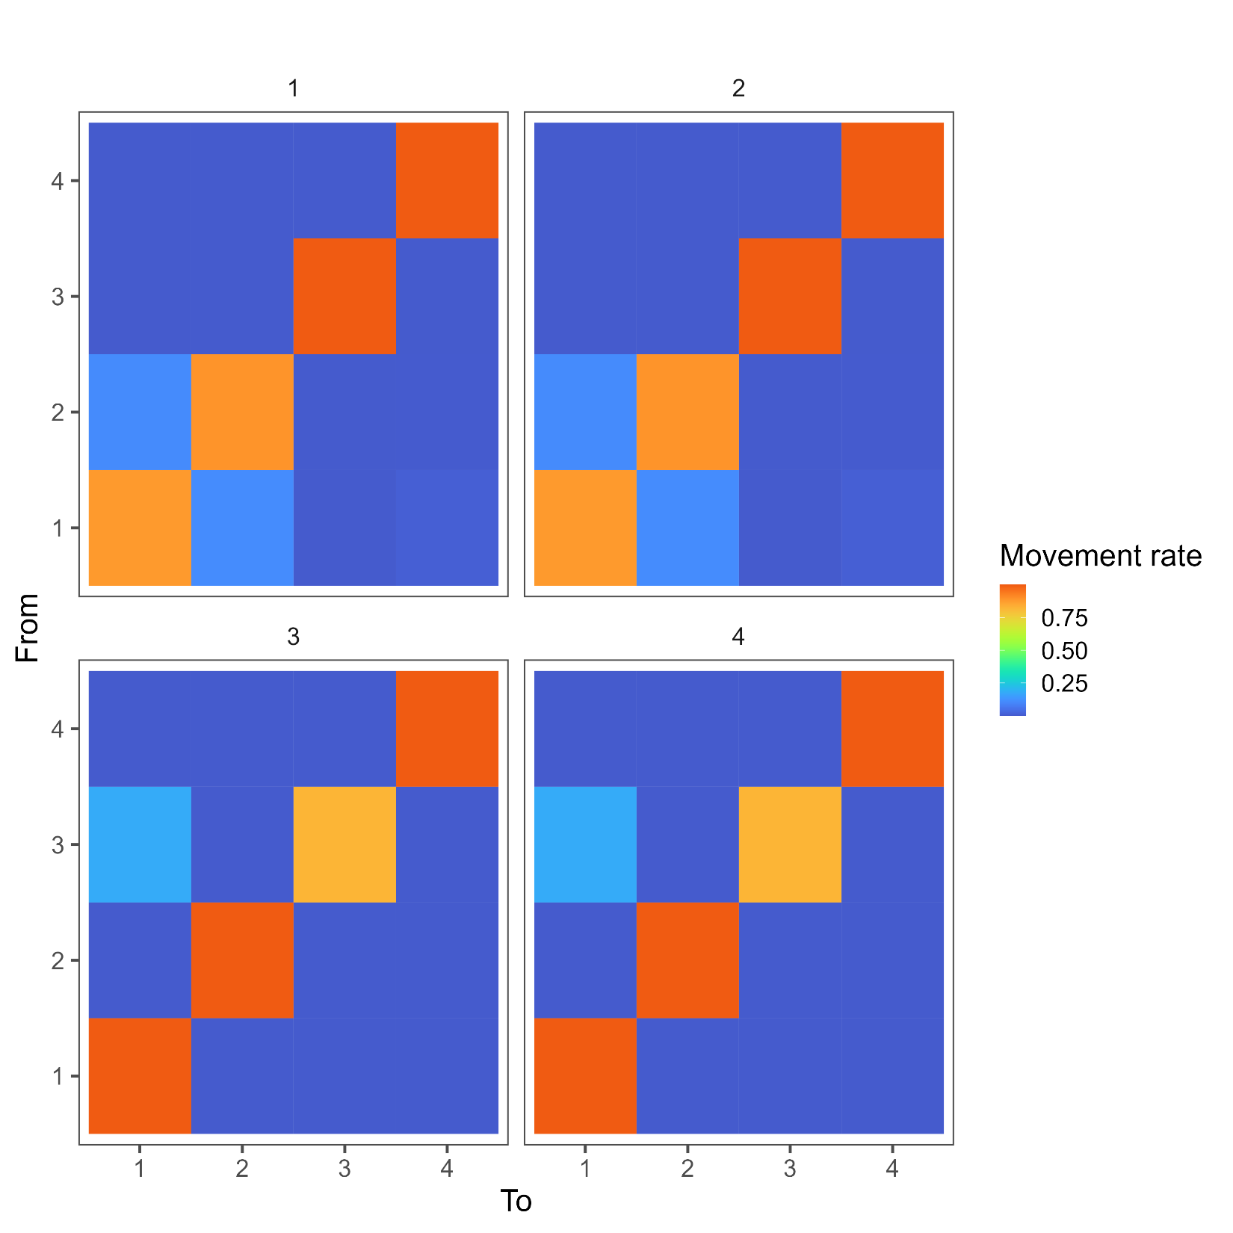
Four region – Refining structure
Movement
Movement “prior” mean: 0 or 0.1
Grouping of quarterly movement
For example: 1 2 3 4 (40 parameters) or 1 1 2 2 (20 parameters)
Age specific movement: none, linear (+1 parameter for each movement coefficient), non-linear (+2 parameters for each movement coefficient)
Recruitment
Tagging data

Slide 42
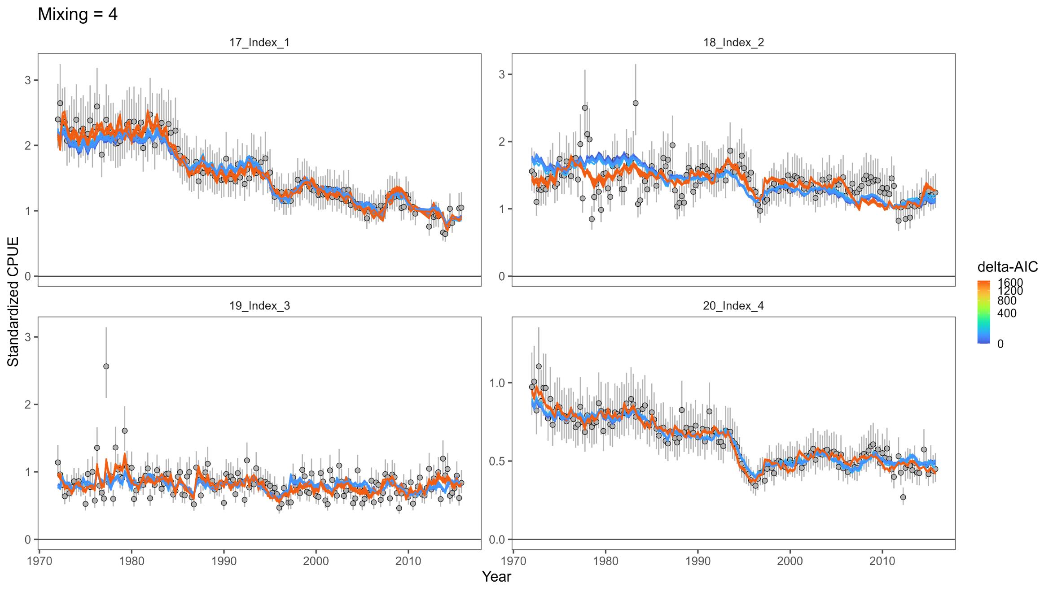
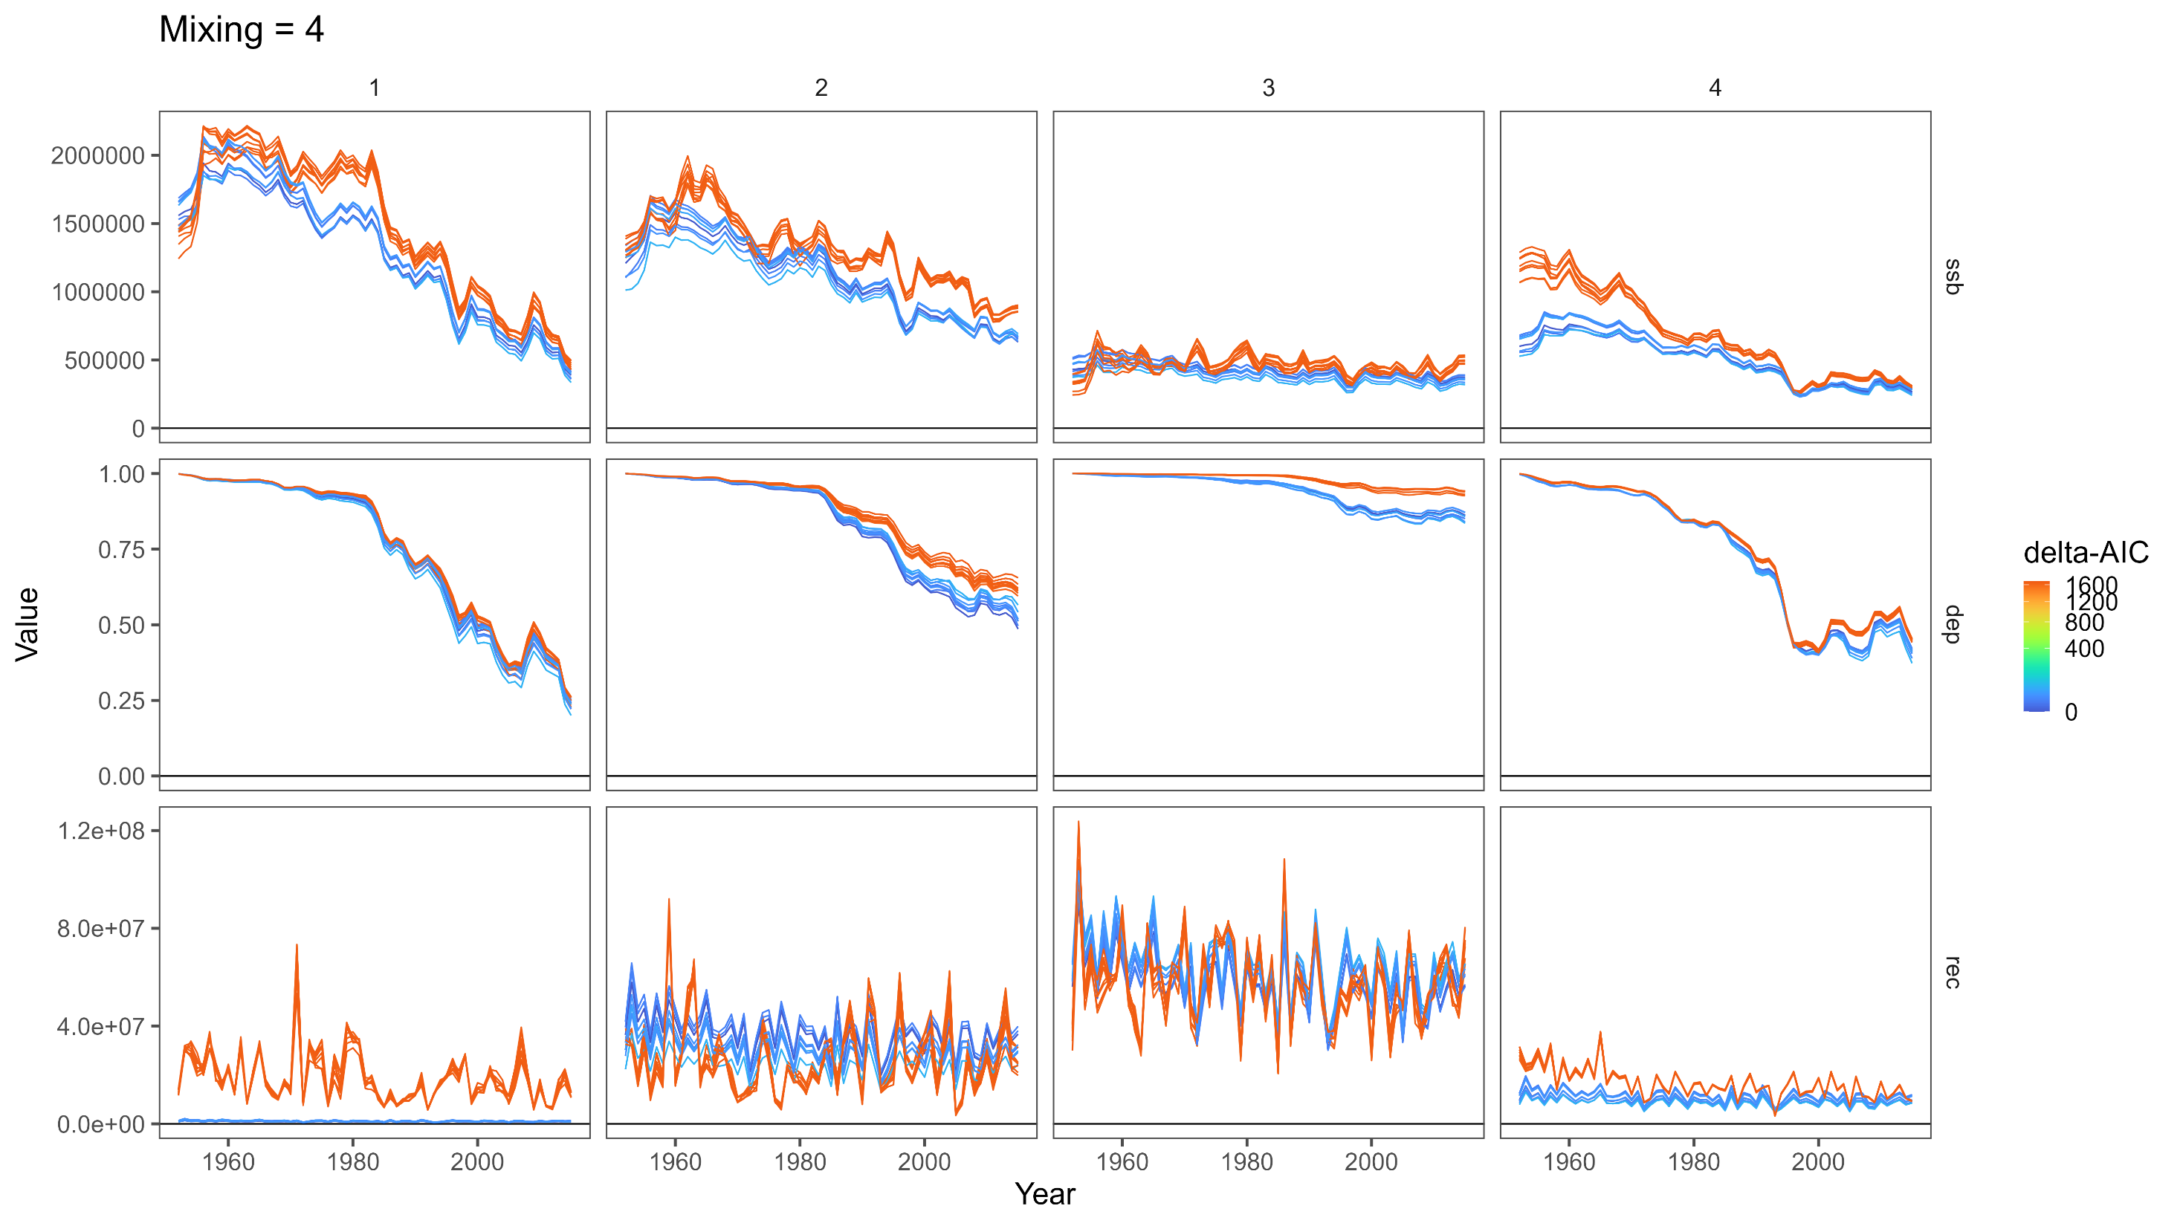
Four region – Refining structure
Movement
Recruitment
Orthogonal polynomial recruitment
Dramatically reduces the number of estimated parameters needed for regional recruitment
Recruitments are constrained to be closer to the mean absent information in the model
Estimation of regional recruitment deviates?
AIC suggested degradation in model fit did not outweigh the reduction in 1020 parameters
Model without regional recruitment deviates did not estimate recruitment in region 1
Estimation of average recruitment distribution:
Tagging data
Region 2: CPUE
Region 1: recruitment
12.8%, 20.8%, 54.4%, and 11.9%

Slide 43
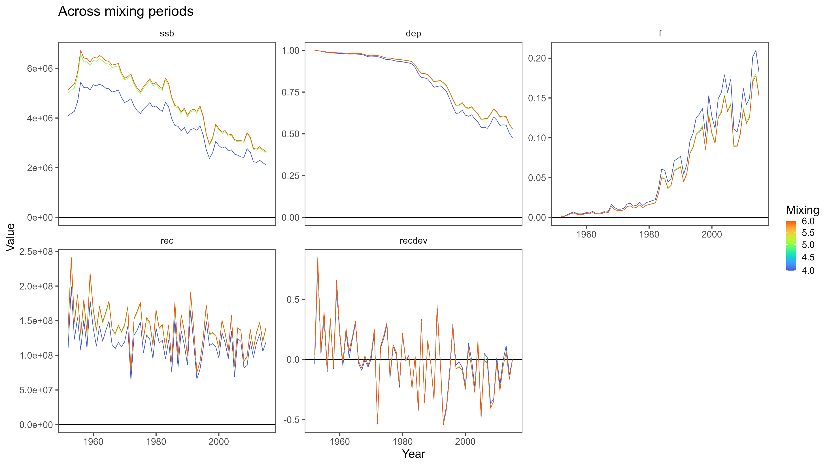
Four region – Refining structure
Movement
Recruitment
Tagging data
Estimated over-dispersion parameter ➔ 1, implying Poisson distribution
Similar to single region model, model scale sensitive to the mixing period assumed though had little impact on fits to CPUE index or length composition data

Slide 44
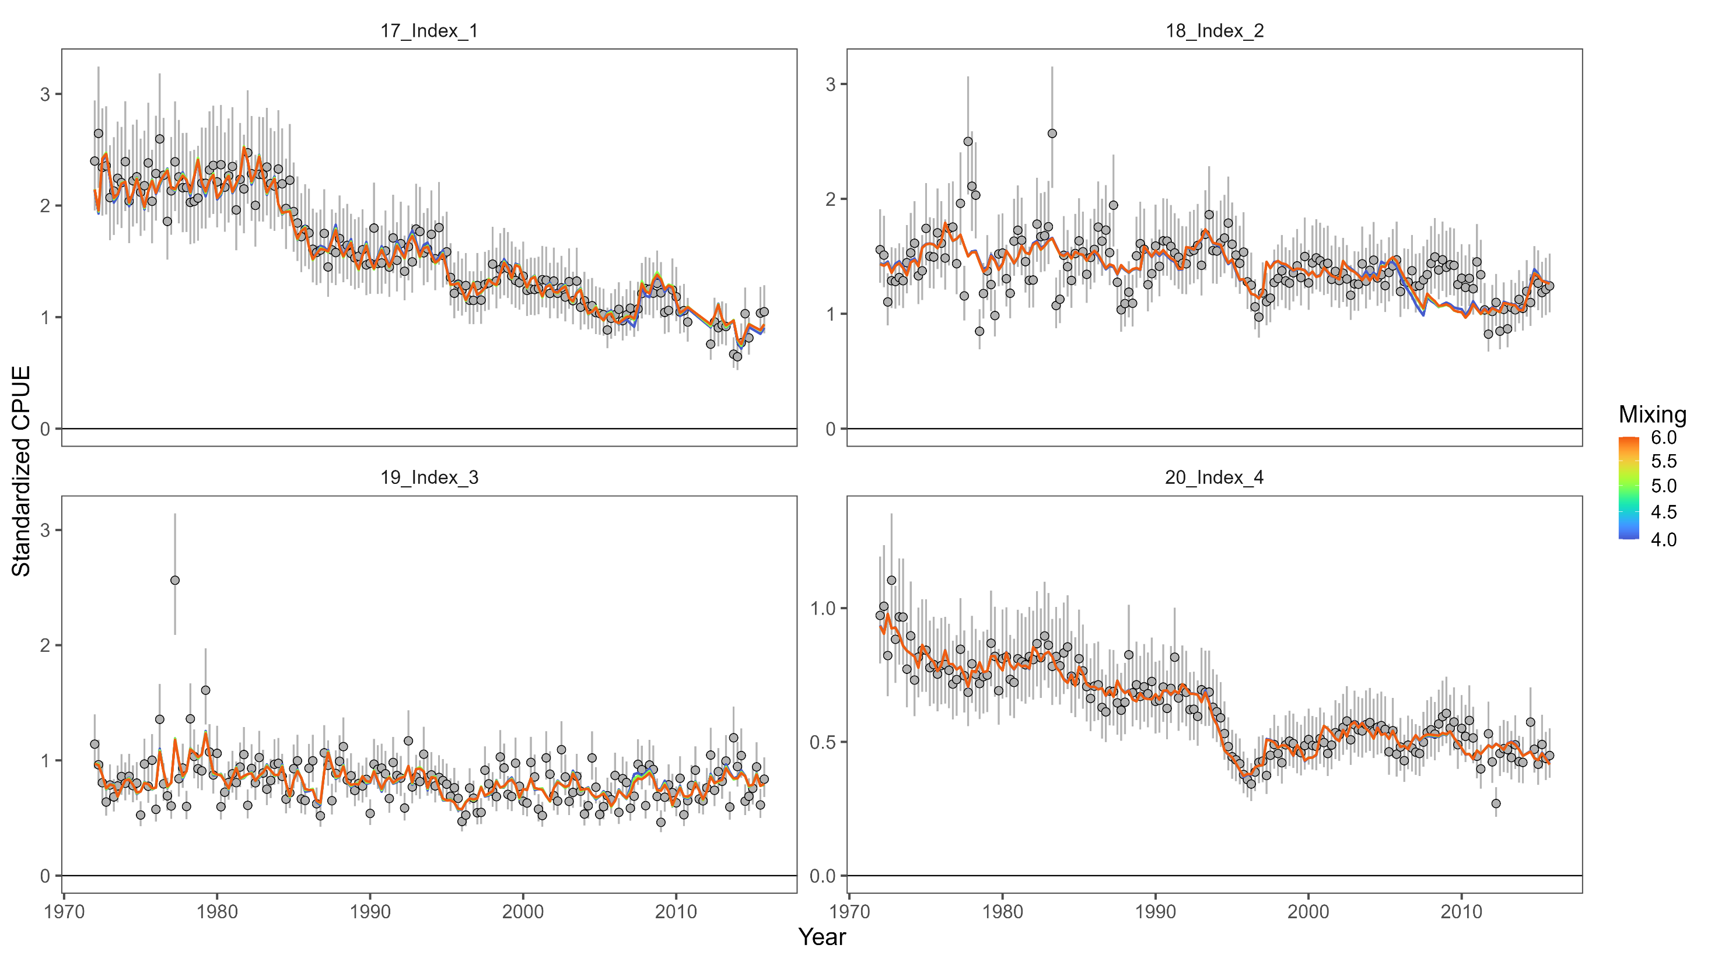
Four region – current model

Slide 45
Four region – current model

Slide 46
Four region – current model

Slide 47
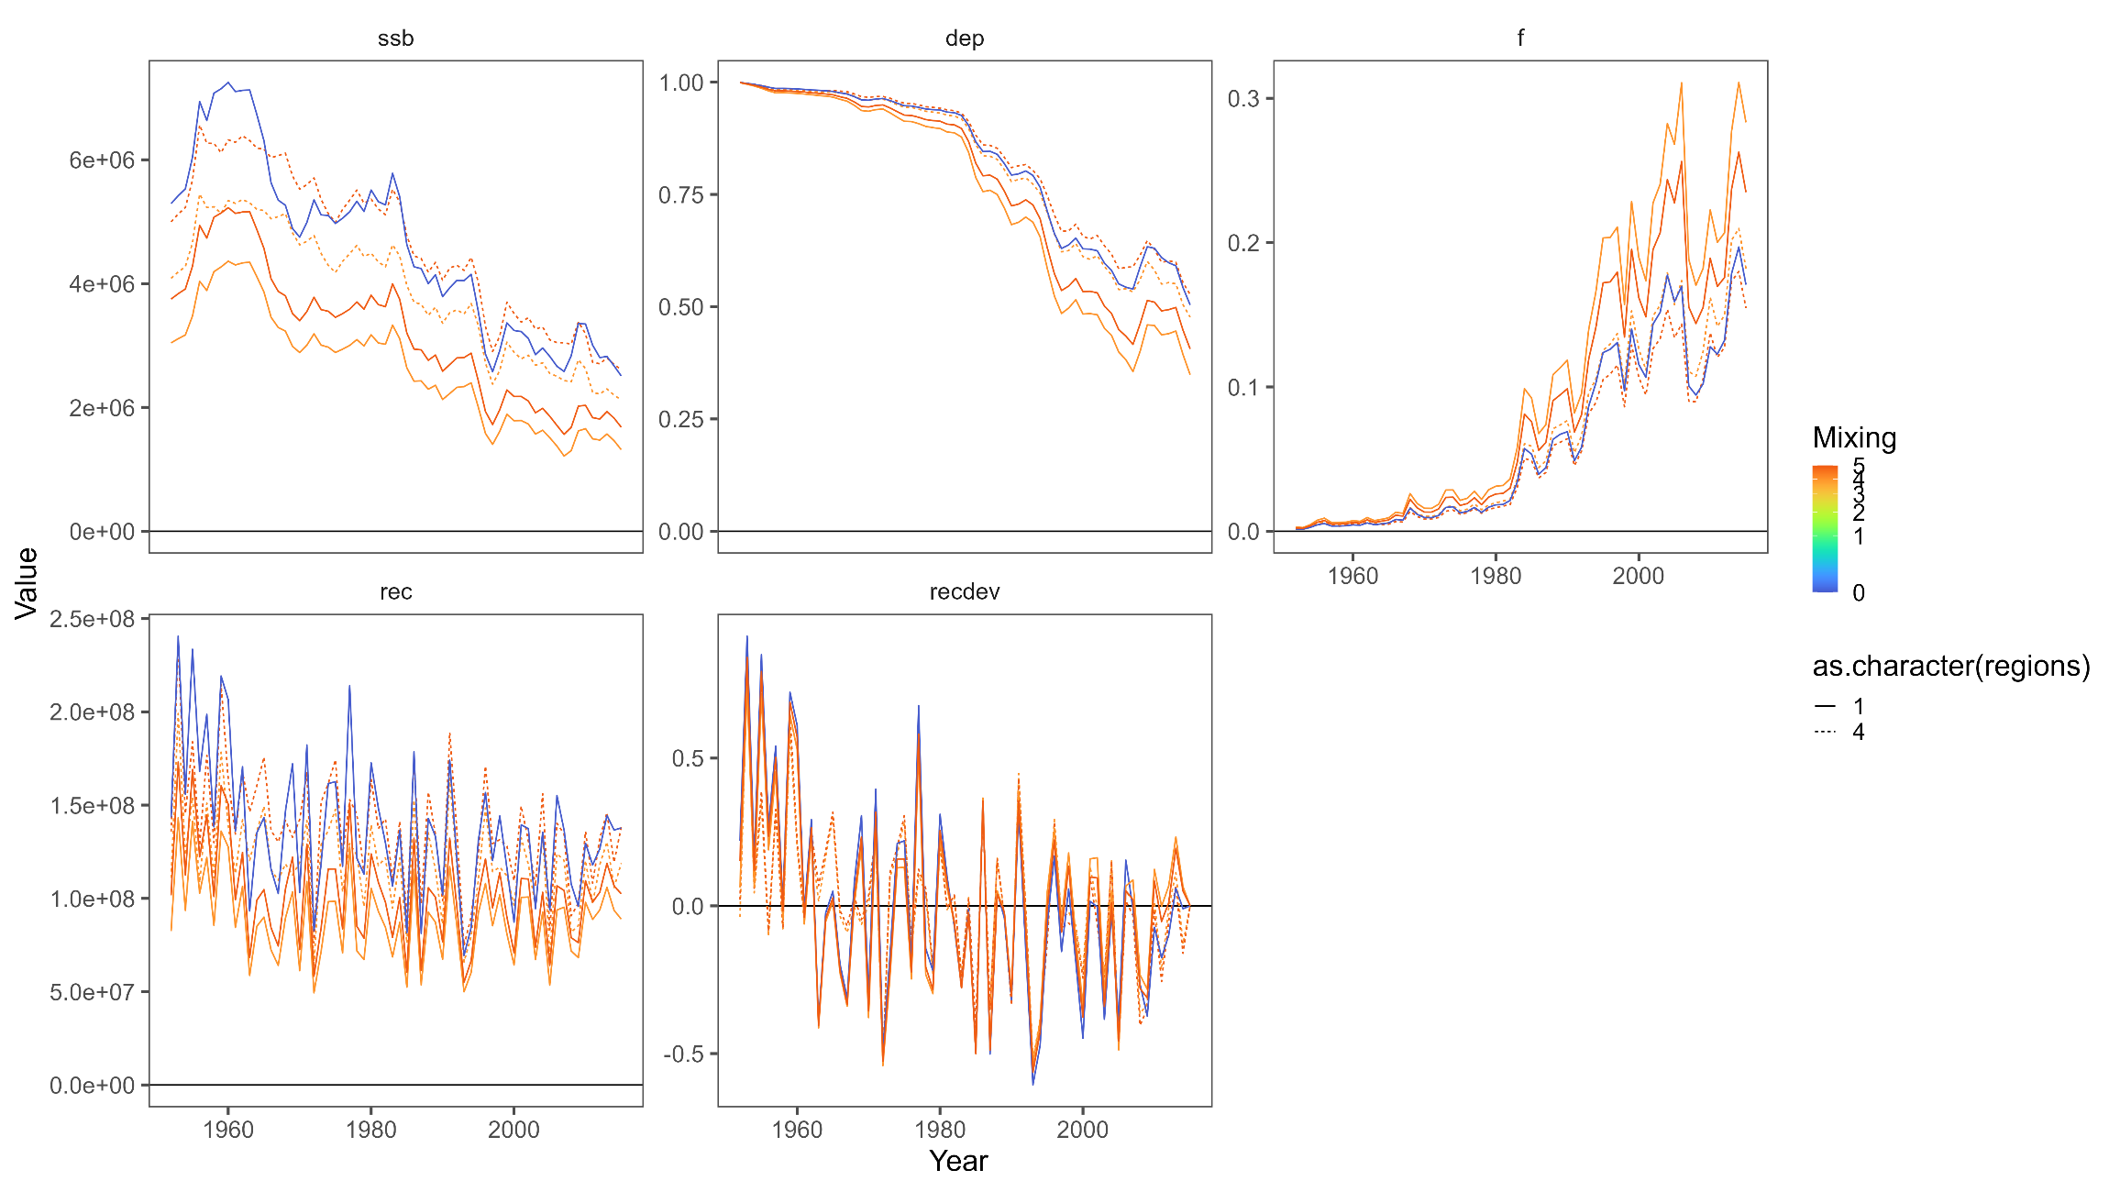
Current model comparison

Slide 48

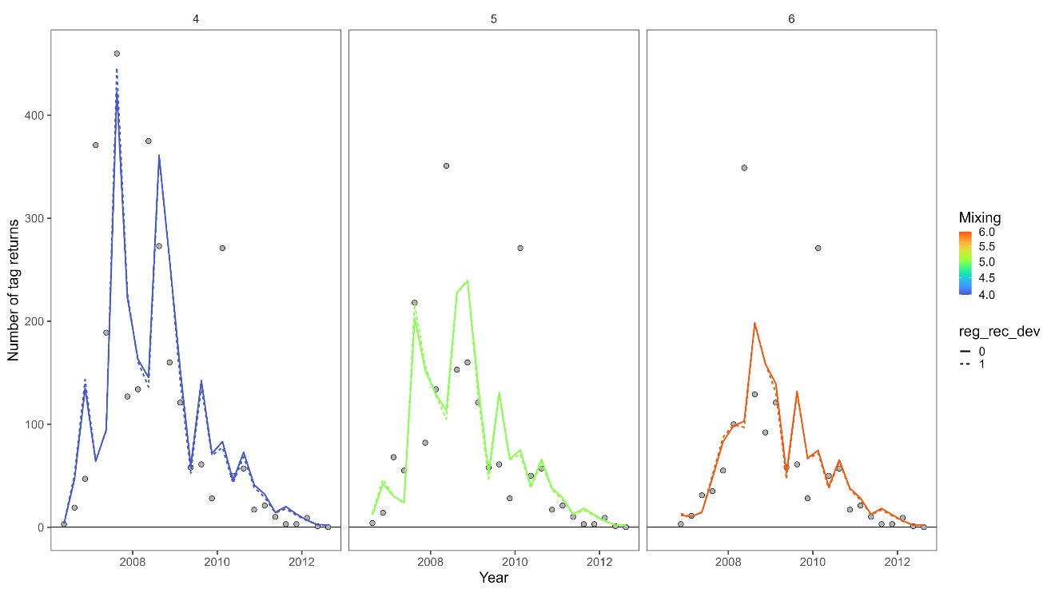
Current model comparison
Single region
Four region

Slide 49
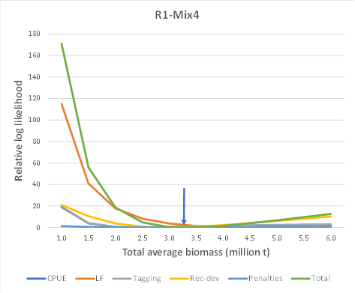
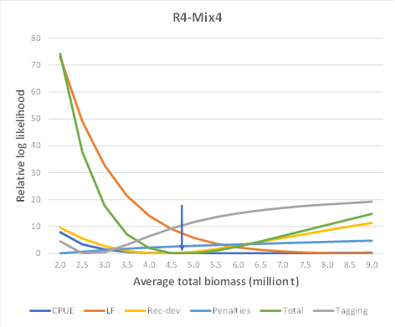
Current model comparison
Single region
Four region

Slide 50
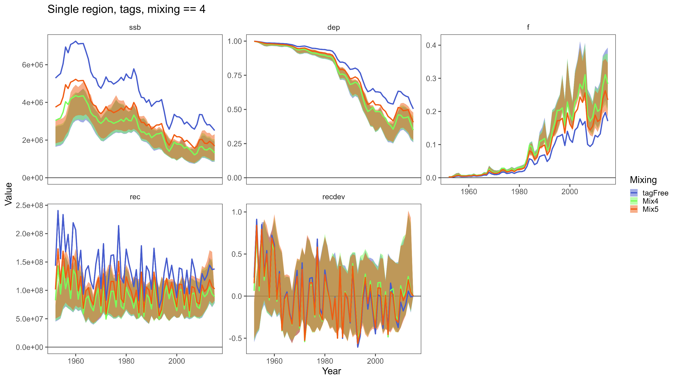
Replicate runs – single region
We thought we were done but something seems off here…

Slide 51
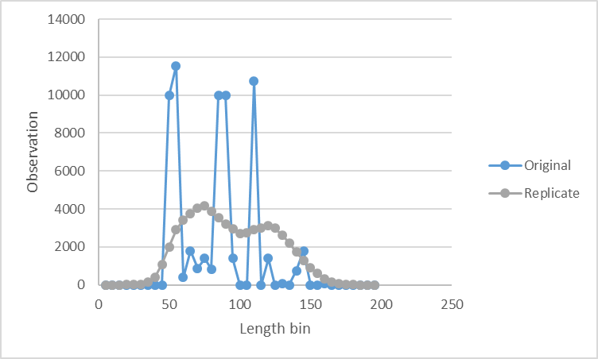
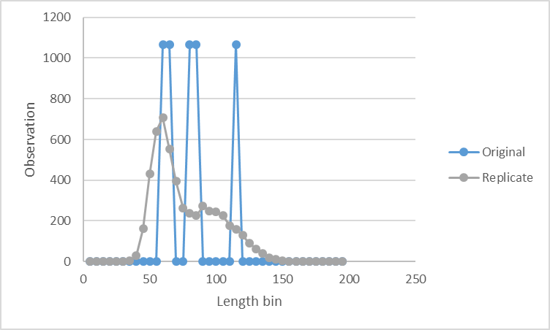
Replicate runs – Length composition
… the composition data used to develop current “final” models appears to be simulated/formatted in a different manner than data used for the replicates.
It looks like we ran the replicates using the *_ESS_00x.Rdata rather than the *_ESS_05x.Rdata used in development of the test models.

Slide 52
Discussion
MULTIFAN-CL strengths
Tagging module
Movement parametrization (movement to non-adjacent regions)
Orthogonal polynomial recruitment parametrization
MULTIFAN-CL development wish list
Time-varying movement
Ability to fix/estimate some movement parameters rather than all or none
Implementation of “early” and “main” recruitment periods
Random effects
Movement, recruitment, time-varying selectivity, etc.
Data wish list
Finer scale composition data (5cm bins are fairly coarse)
Length at release associated with tag data rather than age

Slide 53
Discussion
Future improvements needed for this model…
Address areas of systemic misfits to length composition data, CPUE index, and tagging data
Explore 5x5 spatial data
Revisit selectivity groupings/ fishery structure
Consider seasonal or time-varying selectivity
Evaluate tag releases relative to regional boundaries
Define mixing period lengths by release group
Evaluate regional boundaries relative to tag releases and effort distributions
Continued development of diagnostics for:
Determining appropriate mixing periods
Evaluating fit to tagging data
Evaluating estimated movement rates & what is informing movement
i.e. empirical from tags vs. model estimated movement residual

Slide 54
Discussion
Limitations to implementing spatial stock assessments
Model complexity
Long run times (at least for Multifan-CL)
Sufficient data to estimate additional spatial processes (movement & recruitment)
Lack of tagging data to sufficiently estimate movement
Ideally, length composition data should not drive movement estimates
Spatially varying growth, and irregular spatiotemporal sampling of composition data could bias estimates of movement
General comments (based on WCPFC examples)
In limited investigations, non-spatial models tend to produce lower estimates of stock status (i.e., more depleted) relative to the corresponding spatial model.
Partitioning of fishing mortality and biomass in spatial models leads to “buffering” overall stock status while some model areas show higher levels of depletion.
Lack of region specific reference points means this behavior isn’t always accounted for in management advice.

